Slide 1
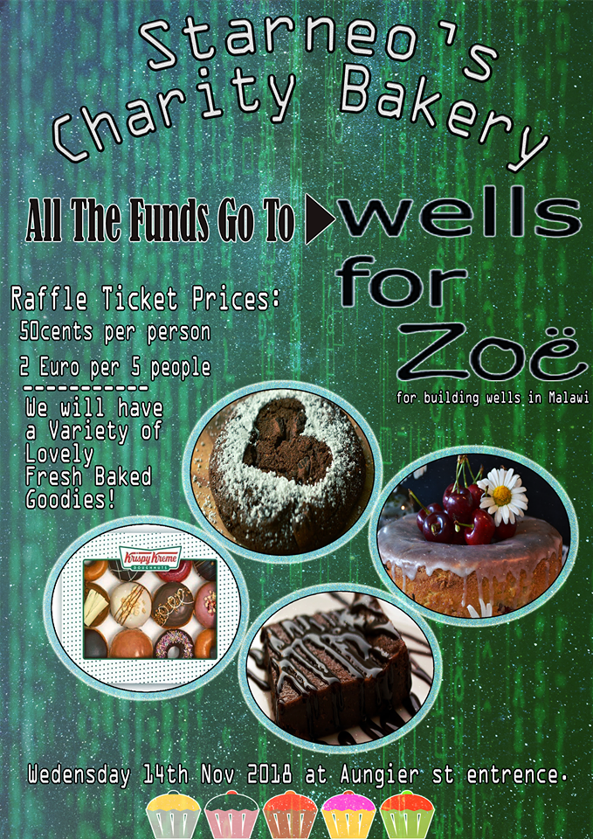
Starneo’s Bake Sale
Team members: Salman Al-samiri, Bianca Palileo, Rianlee Pineda, Cian Doyle, Sumaiya Al Amri, Alexander Bowes

Slide 2
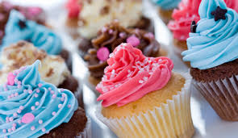
Introduction
You are here to learn about:
Soft skills
How our bake sale went
What we learned from doing the sale

Slide 3

Our fundraising idea
Bake sale
14th November 2018
Aungier Street Foyer

Slide 4

Purpose of the assignment
To develop our:
Ability to self motivate
Teamwork skills
Leadership skills
Ability to work flexibly

Slide 5

Self Motivation
Motivated to receive high marks
We enjoyed working with food
A welcome change

Slide 6

Leadership skills
Each group generally has a leader
assigned
Leaders can direct other members
Encourages initiative among the
members

Slide 7

Teamwork skills
Each member had a key role in the sale
(Bakers, advertising, treasurer, etc…)
All of the roles needed to succeed

Slide 8

Flexibility
The group was required to be flexible
Unexpected complications
Timing was key

Slide 9
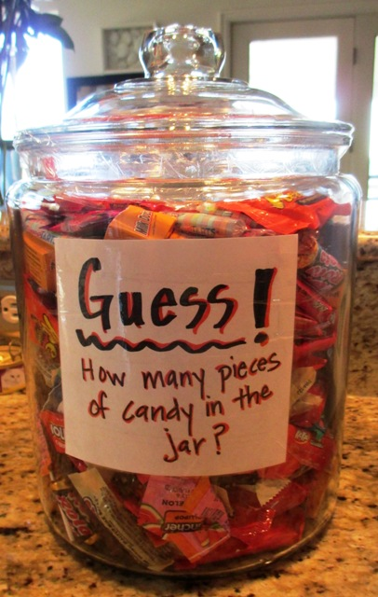
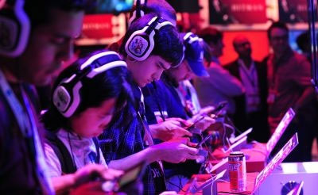
Other ideas
Video games event
Guessing game

Slide 10
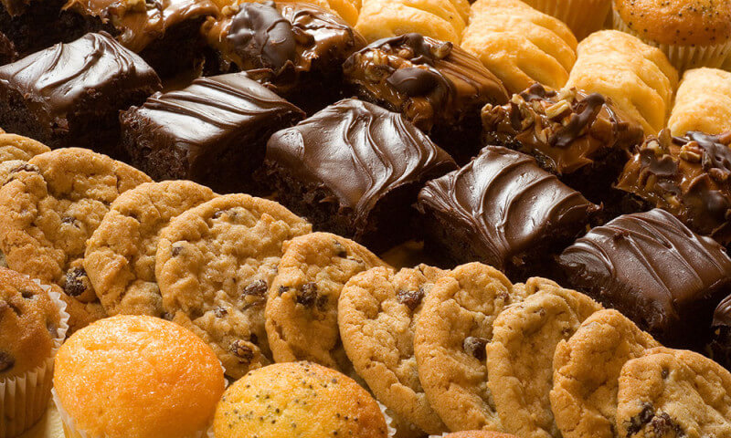
Why Choose This Idea?
Bake sales work well
Easy set up

Slide 11
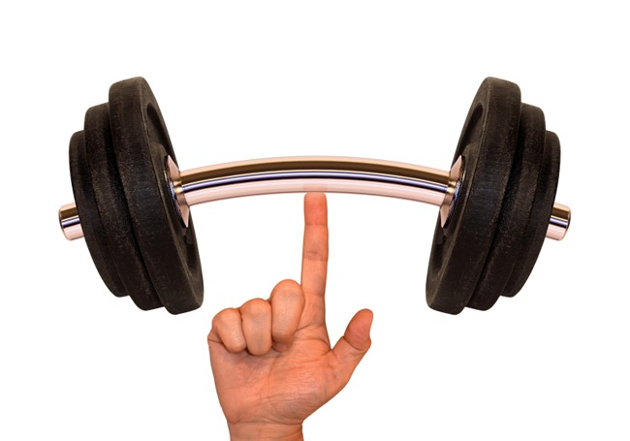
Strengths
Member already with experience
Enthusiasm
Adaptable

Slide 12
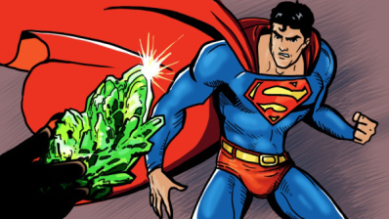
Weaknesses
No experience with selling food
Impatience
Lack of creativity

Slide 13
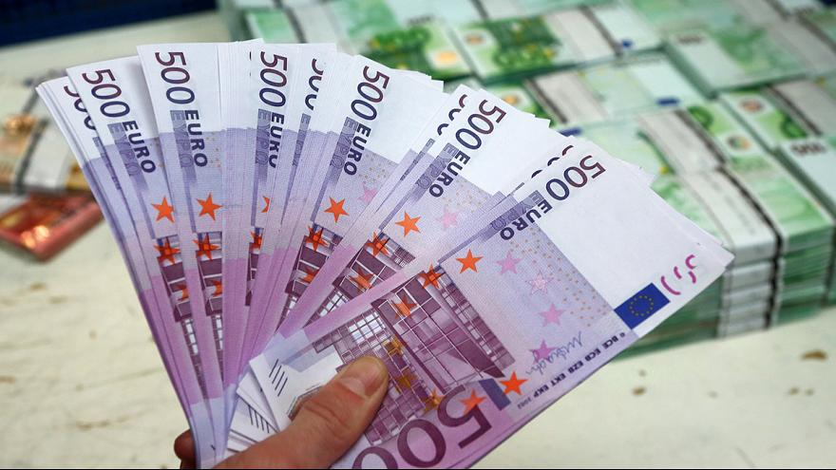
Was it a success?
People bought stuff
Average of 2 euro per person
€144.55 made

Slide 14
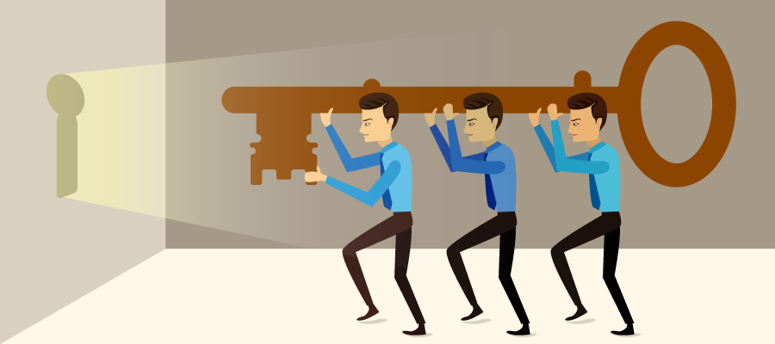
Was it a success? (cont.)
Gained experience in making events
Better time management
Experience with serving people

Slide 15
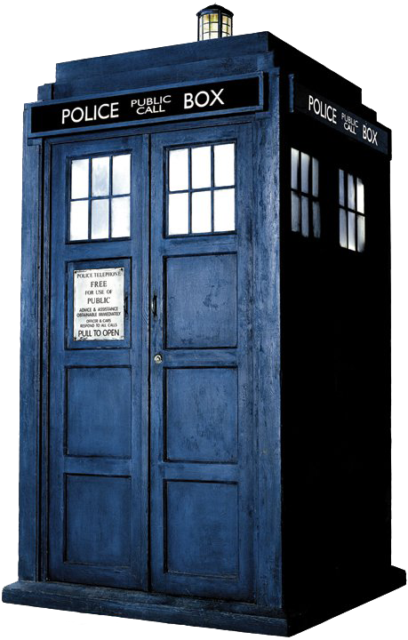
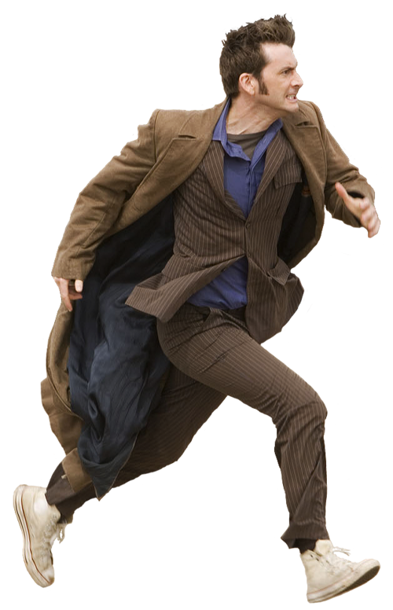
The outcome of this (Past)
The setting of the assignment
Knowing who are the audience
Check on everyone on the team

Slide 16


The outcome of this (Future)
Present application
Futuristic plans
View new ideas

Slide 17

Conclusion
The project developed our soft skills
It was a success
We would recommend the bake sale

